Slide 1


Swimming & diving
Senior student-Athletes
2020-21

Slide 2
Augustana men’s
swimming & diving

Slide 3
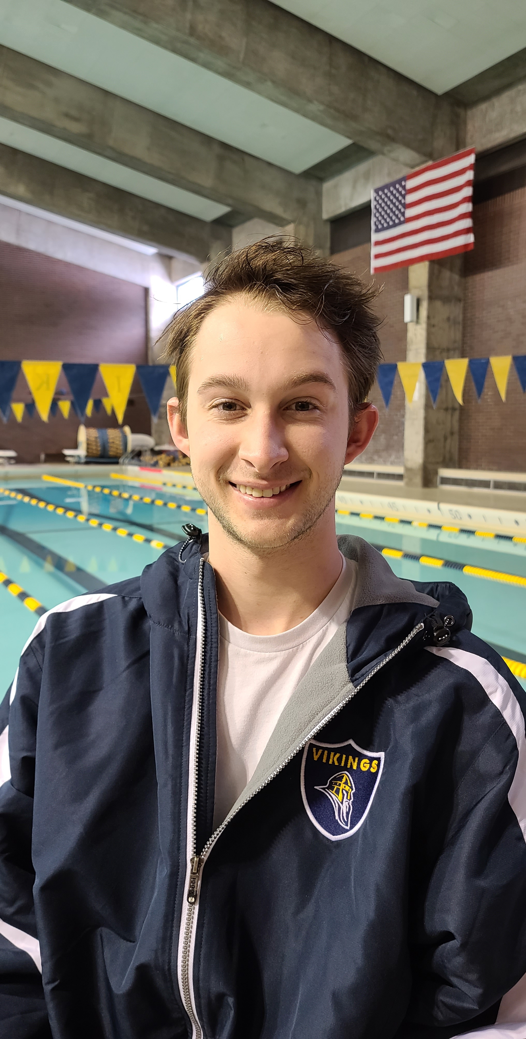
Brett keefe
Hometown: Rockford, Illinois
Academic Major: Biology and neuroscience
Post-Collegiate Plans: Graduate from Augustana and hopefully get a research job studying Alzheimer's and eventually go to graduate school for neuroscience.

Slide 4
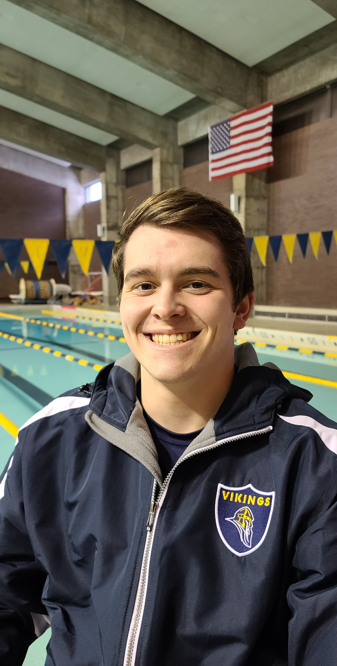
Jason palmer
Hometown: Libertyville, Illinois
Academic Major: Computer Science, French
Post-Collegiate Plans: Looking to gain experience in IT cyber security roles and earn certifications for cyber security best practices.

Slide 5
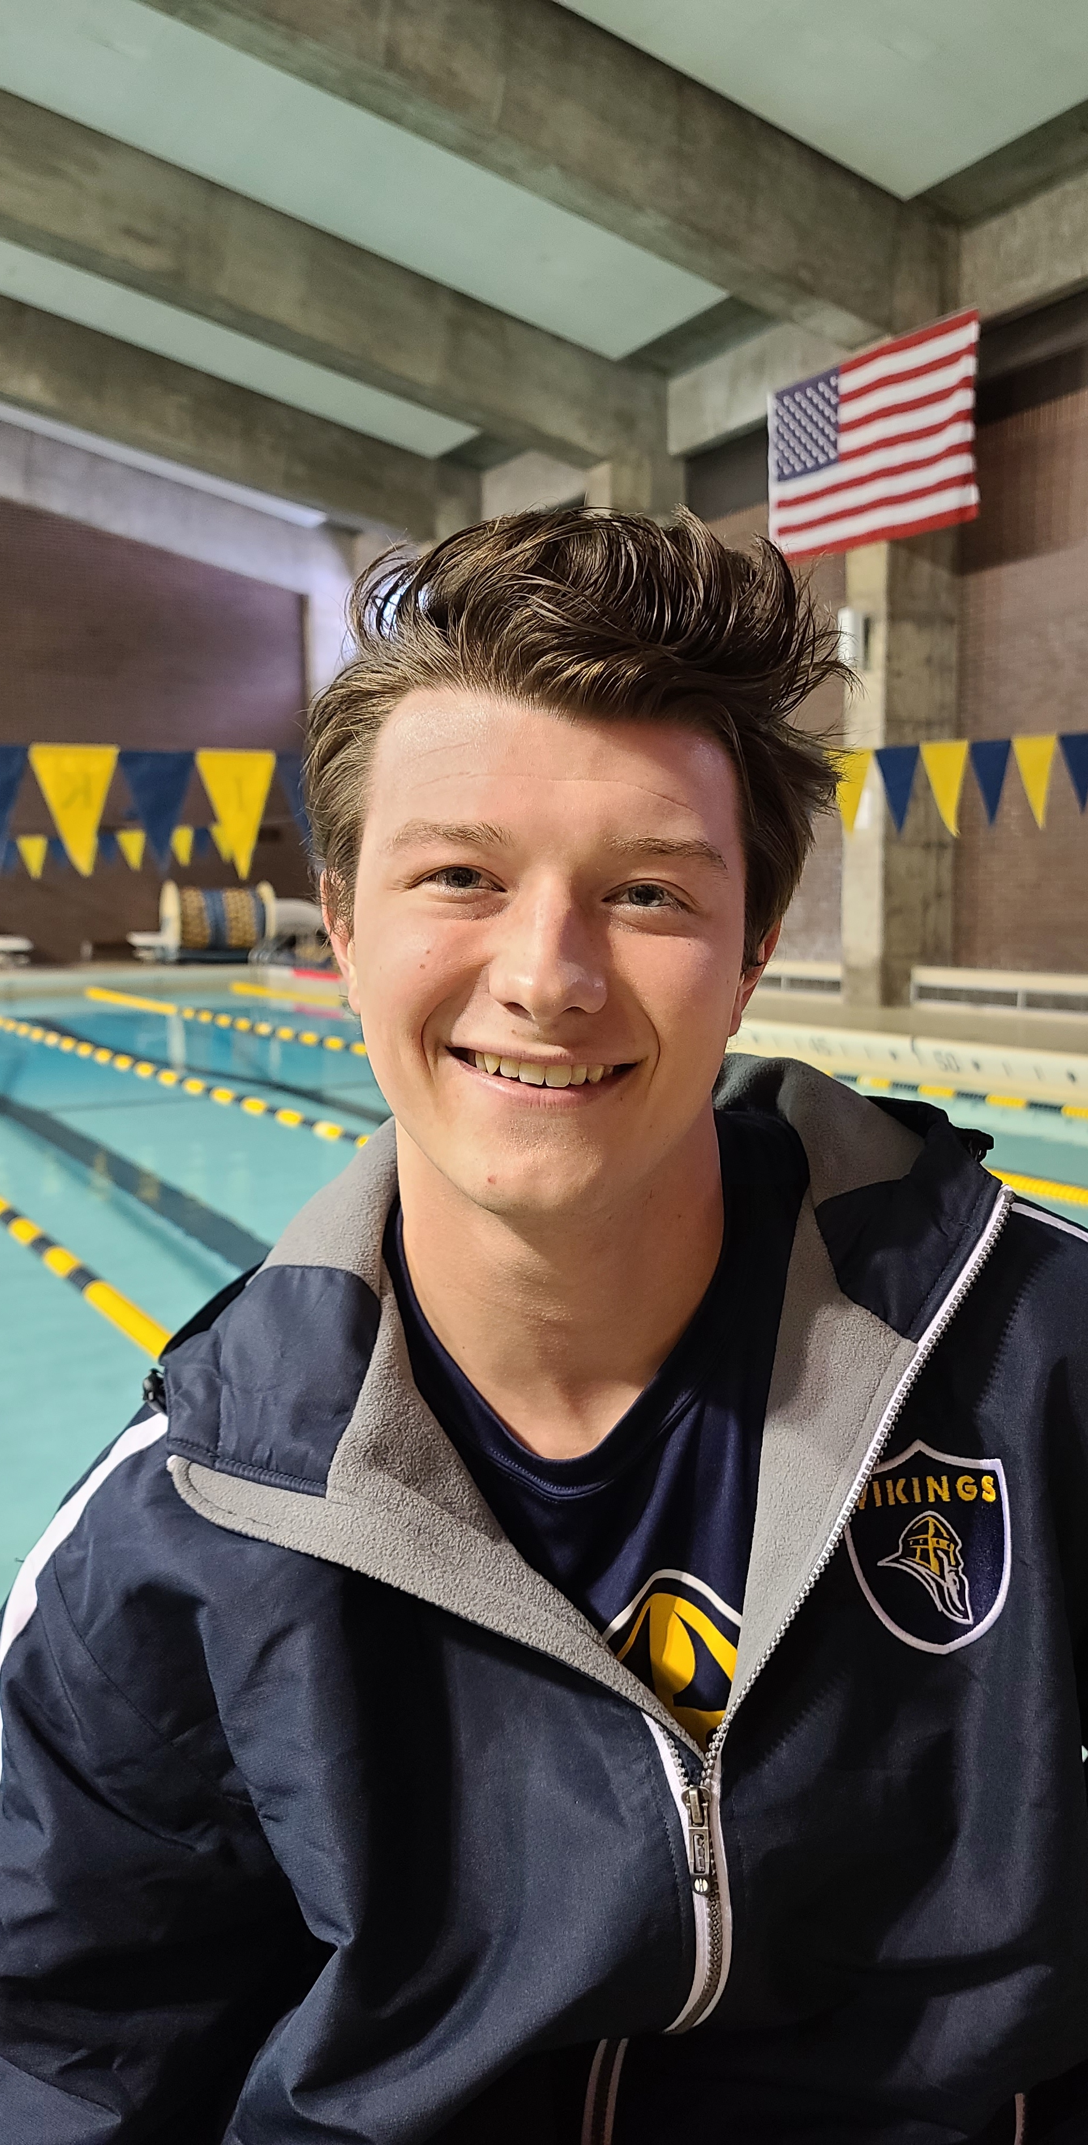
Jeremy Wolf
Hometown: Woodstock, Illinois
Academic Major: Communication
  Academic Minor: MJMC (Multimedia Journalism & Mass Communication)
Post-Collegiate Plans: My plan is to move back home for about a year and pursue a job as a marketing coordinator in the local area. I wanted to give a huge shoutout to my parents, coaches, and teammates for supporting me through these long four years. I wouldn’t have been able to get where I am today, if it weren’t for you guys. Thank you for making my college experience so enjoyable, I’ll miss all of you!

Slide 6
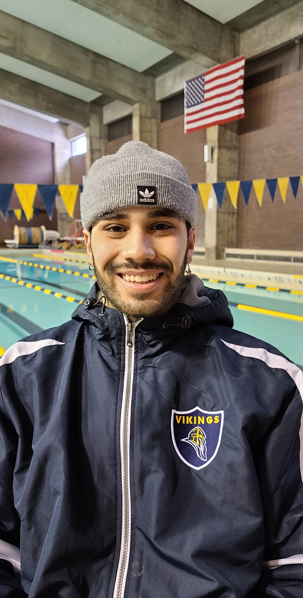
Tito quinones
Hometown: Ramstein, Germany (AFB)
Academic Major: Graphic Design and german
Post-Collegiate Plans: Currently waiting to hear back from deign firms, plan b is OTS for the United States air force…

Slide 7
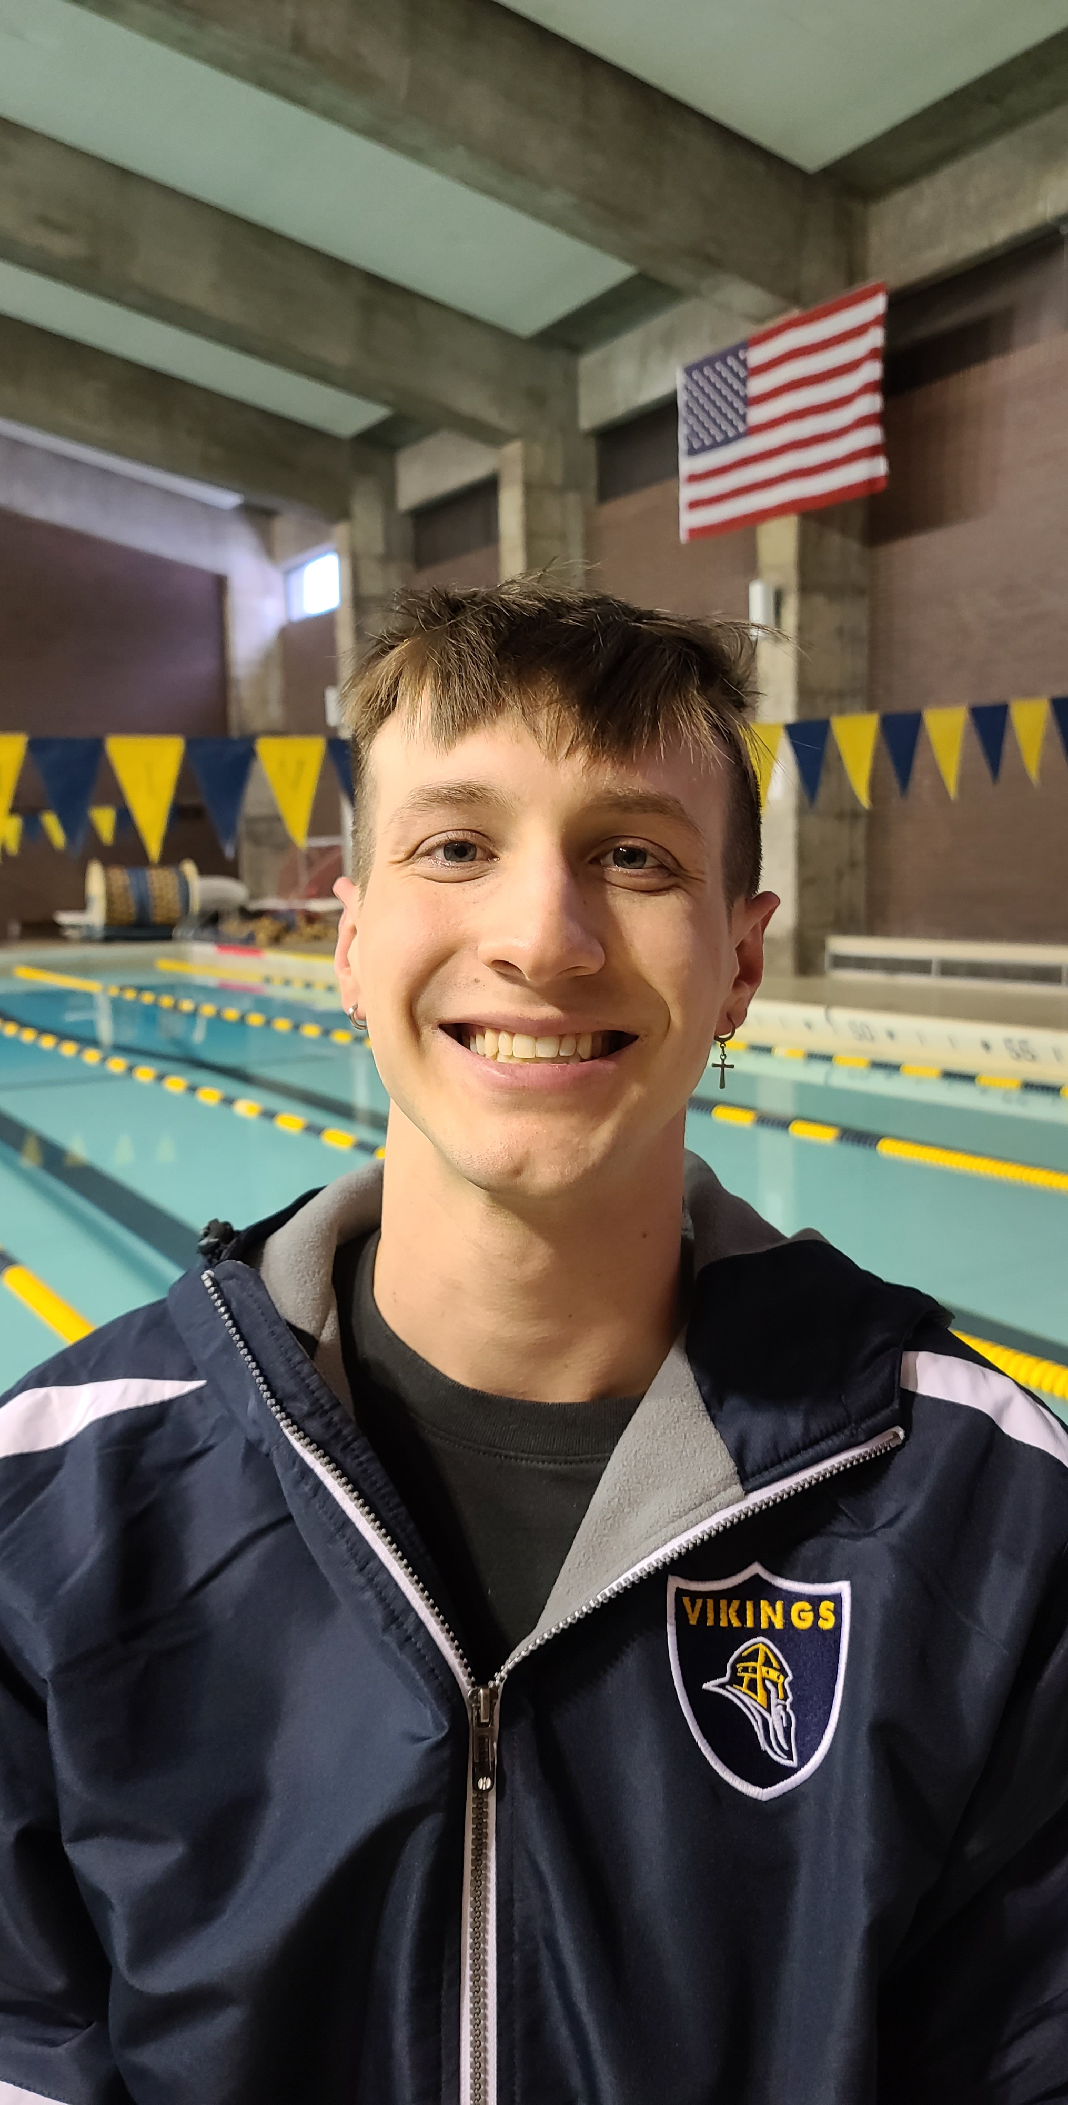
Charles young III
Hometown: Saint Charles, Illinois
Academic Major: Business Administration/Management with a Focus in Finance, Minor in Economics.
Post-Collegiate Plans: Currently in the interview process. There are multiple firms I am interested in. I hope to go into Brokerage, Management/Leadership, or consulting. I also really want to move out of Illinois.

Slide 8
Augustana women’s
swimming & diving

Slide 9
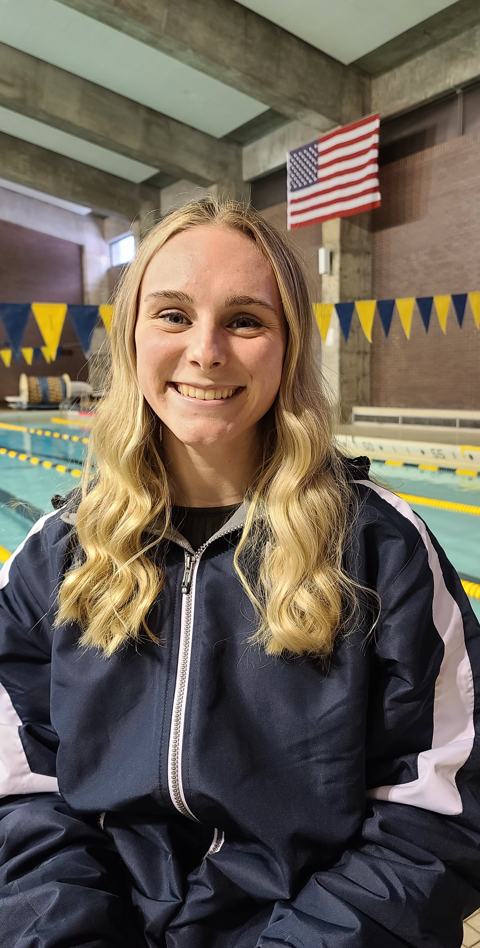
Marissa jaskae
Hometown: Aurora, Illinois
Academic Major: Biology Education and Middle Grades Science
Post-Collegiate Plans: I hope to teach high school biology at a Chicagoland high school and also coach swimming or water polo at the high school level.

Slide 10
Carroll men’s
swimming & diving

Slide 11
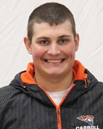
Damian barkow
Hometown: West Bend, Wisconsin
Academic Major: Biochemistry w/ Pharmacy Emphasis
Post-Collegiate Plans: The current plan is to finish out my Bachelor’s degree at Carroll University. After that, I plan to move into some sort of a biochemistry career path for a few years with the eventual goal of going back to pharmacy school to become a Pharmacist down the line.

Slide 12
carroll women’s
swimming & diving

Slide 13
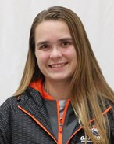
Jordan Andrews
Hometown: Belvidere, Illinois
Academic Major: Exercise Science, Pre Physical Therapy Emphasis
Post-Collegiate Plans: After I obtain a doctorate from Carroll University’s Physical Therapy graduate program, I hope to find a job in an outpatient-clinic working with athletes. Meanwhile, I would like to find time to travel and create new experiences along the way.

Slide 14
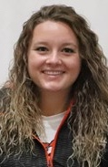
Lindsey coons
Hometown: Neenah, Wisconsin
Academic Major: Communications
Post-Collegiate Plans: Currently, undecided on any post-collegiate plans.

Slide 15
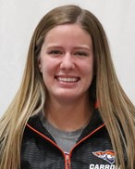
Sara janz
Hometown: Mukwonago, WI
Academic Major: Exercise Science Pre Clinical Exercise Physiology
Post-Collegiate Plans: Attend Carroll’s Graduate program for clinical exercise physiology and get a job somewhere in the cardiac or cancer rehab setting! Maybe travel to a couple states down south too, just for the memories.

Slide 16
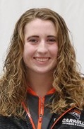
Amanda klaeser
Hometown: Winneconne, Wisconsin
Academic Major: Public Health (Pre-Occupational Therapy)
Post-Collegiate Plans: Graduate school for Occupational Therapy.

Slide 17
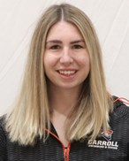
Allison kriegler
Hometown: Algonquin, Illinois
Academic Major: Public Health, Pre-Occupational Therapy
Post-Collegiate Plans: After graduation, I will be pursuing my master’s degree in occupational therapy with a focus on pediatrics. I look forward to continuing my passion for swimming by joining a master's swim team.

Slide 18
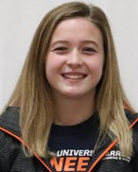
Erin paschke
Hometown: Spring Grove, Illinois
Academic Major: Nursing
Post-Collegiate Plans: I plan to finish up my undergraduate nursing degree next year. I plan to gain experience in nursing and then continue my education in a graduate nursing program.

Slide 19
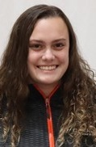
Natasha pellegrini
Hometown: Waukesha, Wisconsin
Academic Major: English & Writing and Political Science
Post-Collegiate Plans: I will be taking one year off to prepare for law school. I hope to work at a law firm in the meantime and relax!

Slide 20
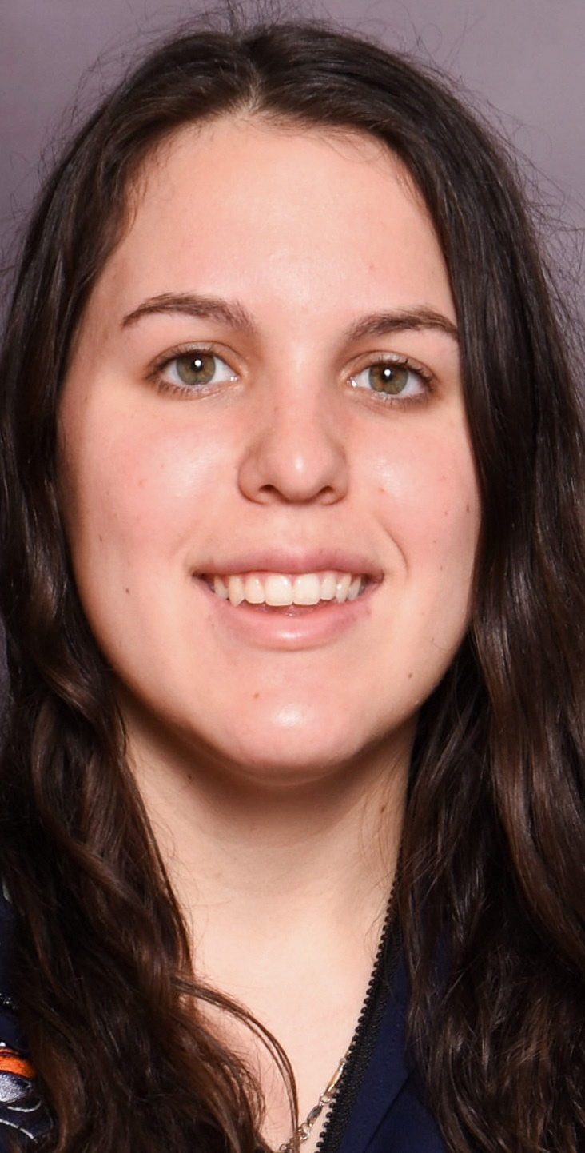
Ellie walecka
Hometown: Kewaunee, Wisconsin
Academic Major: Physical and Health Education
Post-Collegiate Plans: After college I am planning to start teaching either High School or Middle School. I also plan on coaching a sport for a high school. After three years of teaching I plan on going back to school for my masters and possibly to get my doctorate after that.

Slide 21

Carthage men’s
swimming & diving

Slide 22
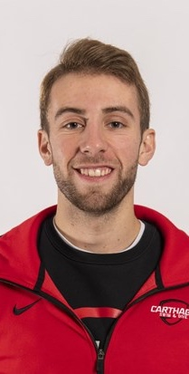
Ethan hare
Hometown: Cary, Illinois
Academic Major: Biology
Post-Collegiate Plans: I will be attending medical school at Nova Southeastern University in Fort Lauderdale.

Slide 23
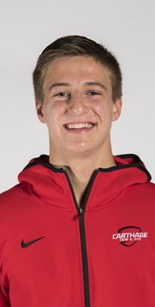
Mitchell mages
Hometown: Skokie, Illinois
Academic Major: Communications Major
  Film and New Media Minor
Post-Collegiate Plans: Mitchell will be taking a 5th year here at Carthage as a graduate student working toward a master’s in business and thanks to the NCAA waiver, he will be able to swim as well. After that he plans on building his multimedia company Mages Media and adding value to the world through art.

Slide 24
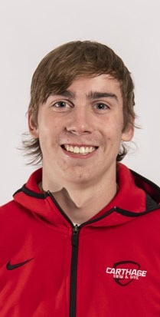
Alec makenas
Hometown: Alsip, Illinois
Academic Major: Special Education and Elementary Education
Post-Collegiate Plans: After college, I will be serving in the United States Navy.

Slide 25
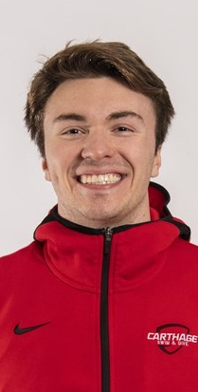
Nick nevins
Hometown: Hoffman Estates Illinois
Academic Major: Exercise Sports Science
Post-Collegiate Plans: To complete student teaching in the fall and following that, enroll in culinary school to pursue a career in the restaurant industry.

Slide 26
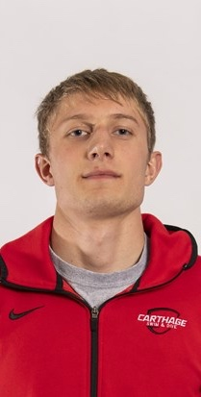
Mitchel steinke
Hometown: Sioux Falls, South Dakota
Academic Major: History
  Minor: Political Science
Post-Collegiate Plans: After graduation I plan on attending law school. Until then, I plan on spending time with family and friends.

Slide 27
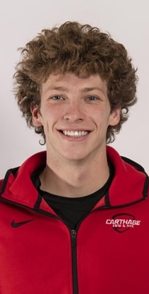
David vowels
Hometown: Dousman, Wisconsin
Academic Major: Exercise & Sport Science

Slide 28
Carthage women’s
swimming & diving

Slide 29
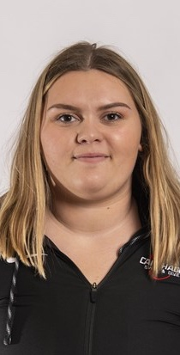
Sydney feenstra
Hometown: Farmington, Michigan
Academic Major: Exercise sports science with minors in health and education
Post-Collegiate Plans: Upon graduation I plan on staying in the Wisconsin area. I hope to be teaching physical education and health at the high school level.

Slide 30
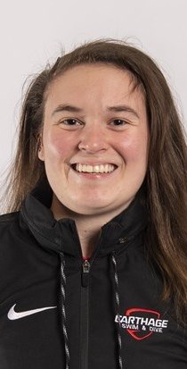
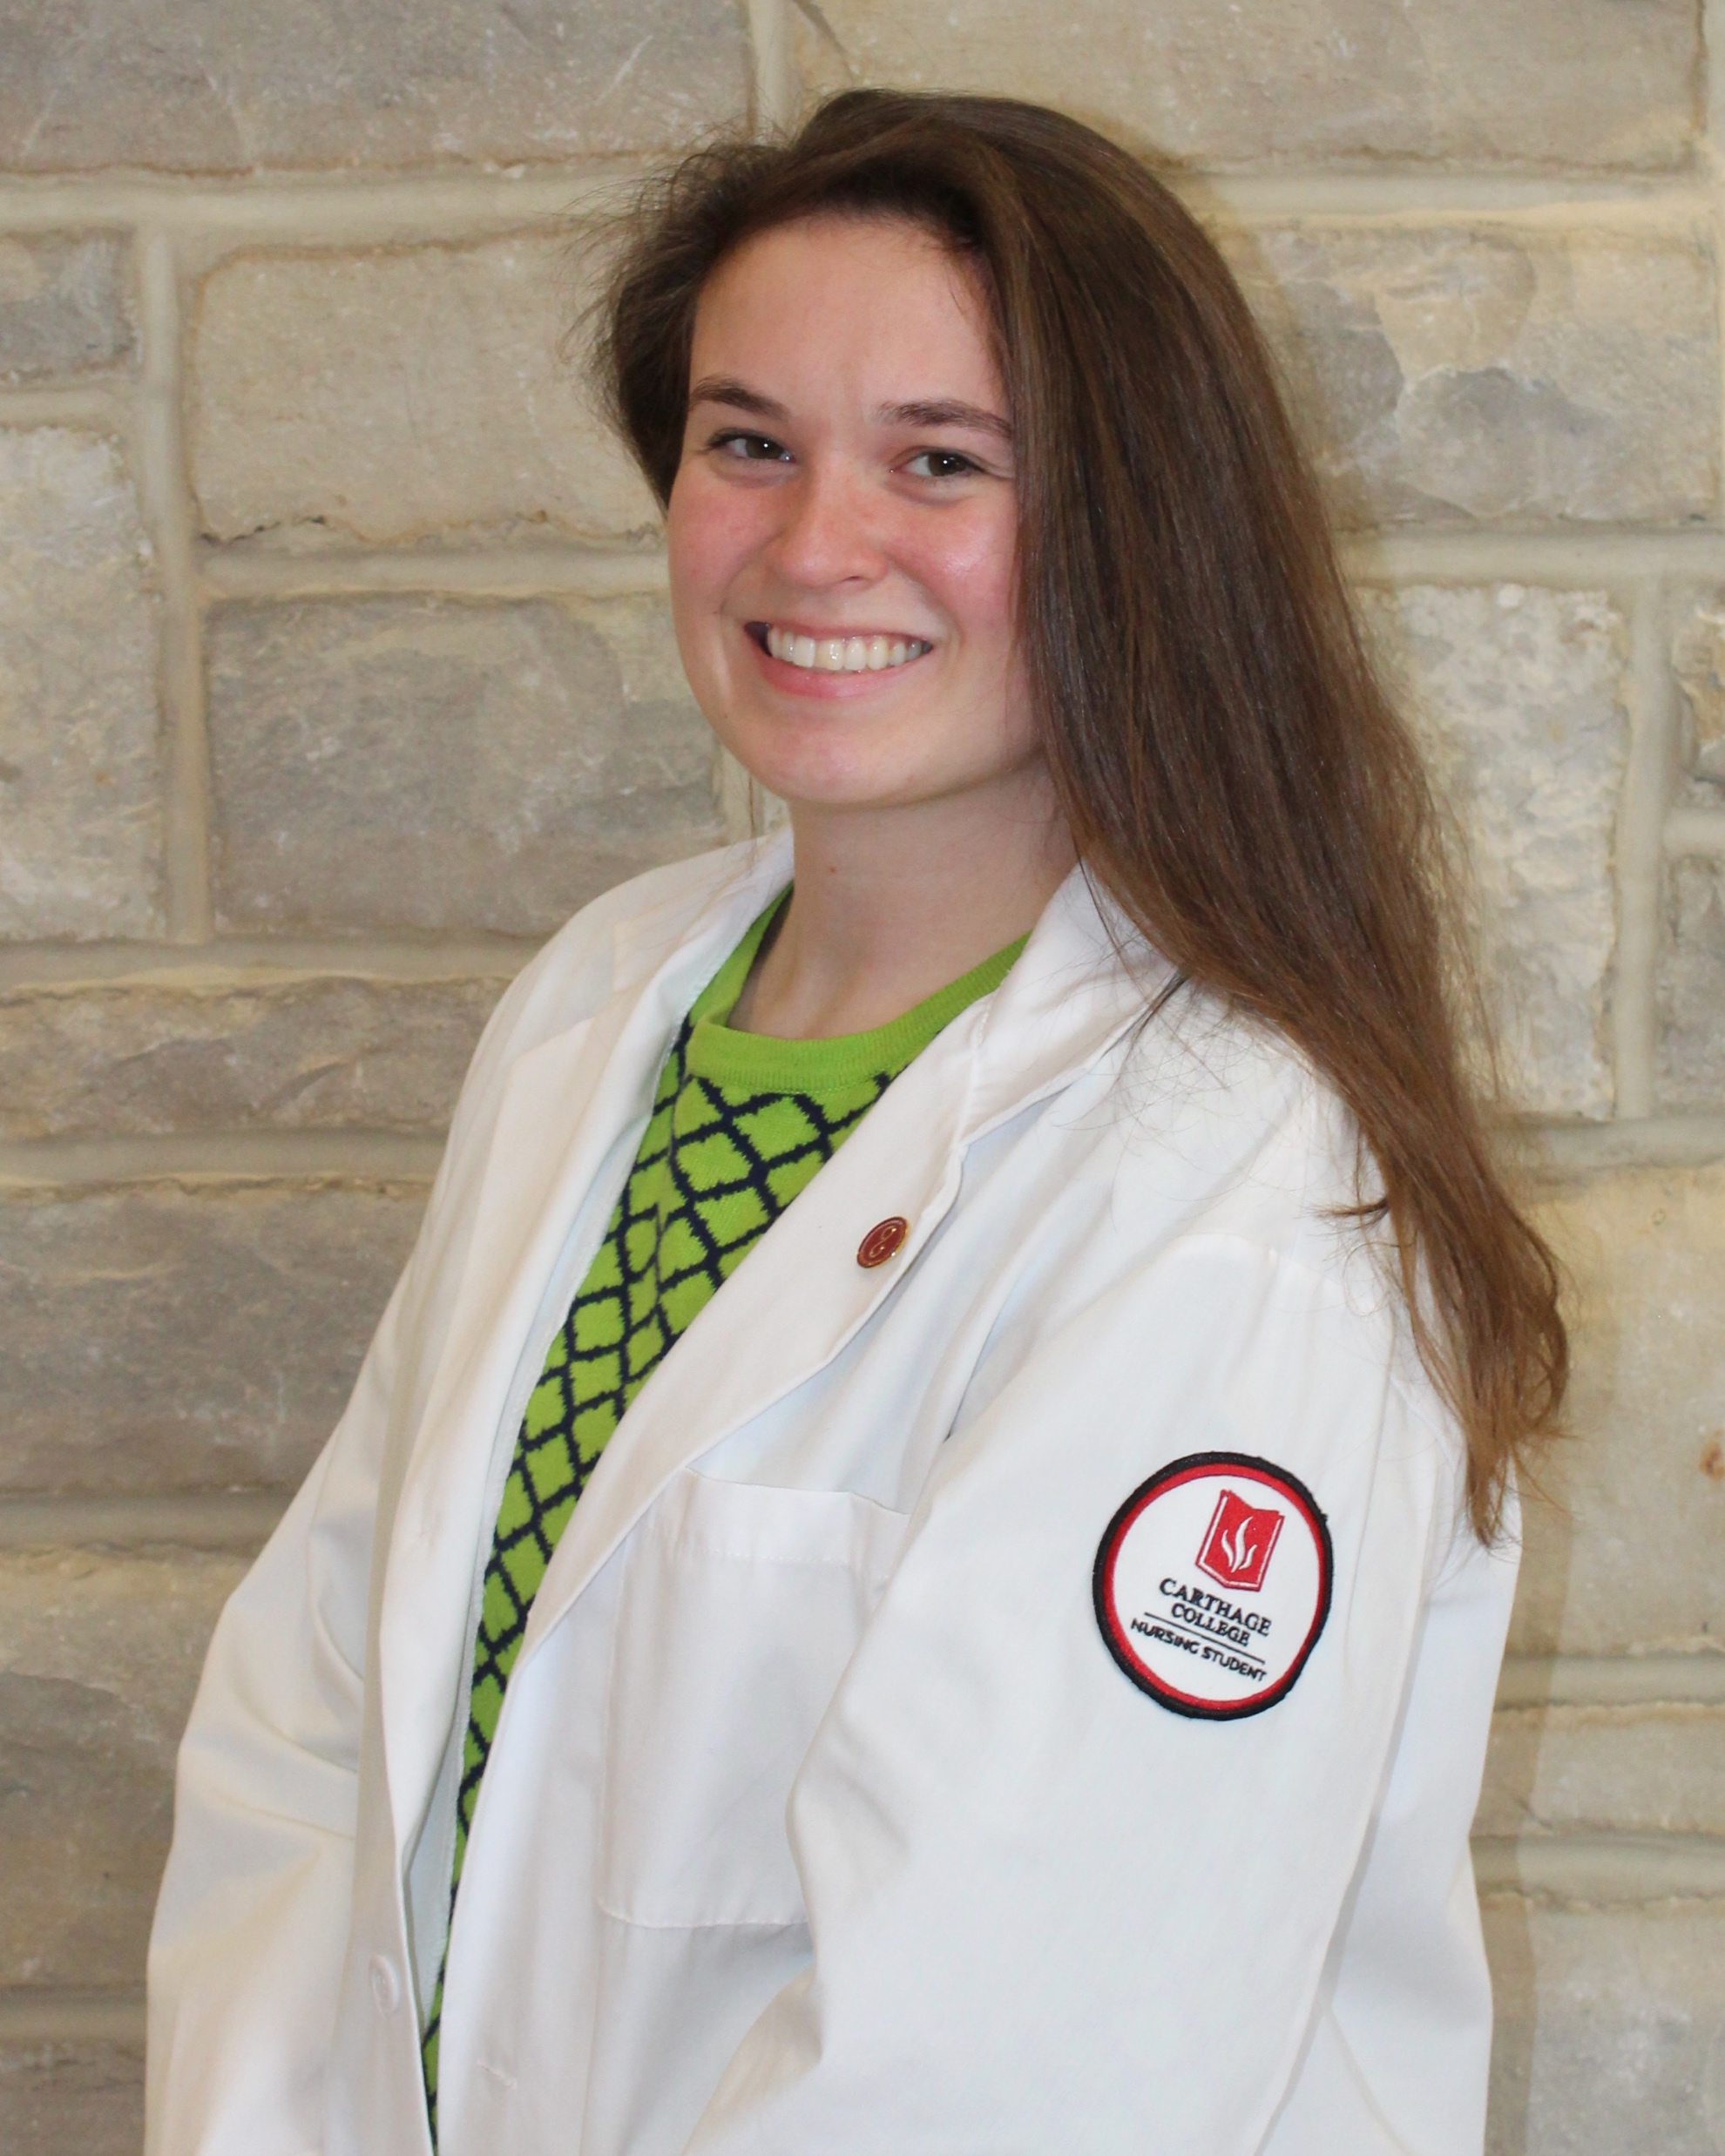
Allison marsh
Hometown: Elgin, Illinois
Academic Major: Nursing
Post-Collegiate Plans: to work in hospice care and further academics in nursing. Also, plans to join a masters team for swimming.

Slide 31

Illinois Wesleyan women’s
swimming & diving

Slide 32
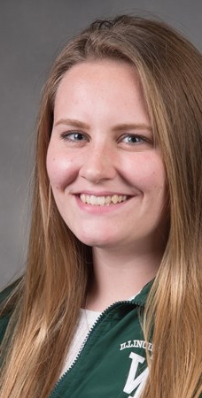
Lauren ebert
Hometown: Big Lake, Minnesota
Academic Major: Biology
Post-Collegiate Plans: I plan to attend medical school.

Slide 33
Millikin women’s
swimming & diving

Slide 34
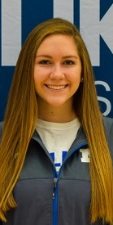
Milissa gegg
Hometown: St. Louis, Missouri
Academic Major: BA Music Major: Emphasis in Violin / Minor in Digital Media Marketing
  (I’m also getting a Certificate in both Graphic Design and Digital Photography)
Post-Collegiate Plans: I am heading back to St. louis to find an internship or job within Digital Media Design. I hope to do photography work on the side, along with continuing to play the violin in a community orchestra.

Slide 35
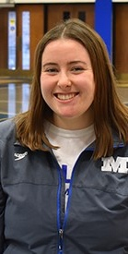
Hannah sweeney
Hometown: Urbana, Illinois
(MacMurray College transfer)
Academic Major: Nursing
Post-Collegiate Plans: After college, I will be working as a nurse at St. John’s Hospital in Springfield on the pediatric floor. I hope to work as a travel nurse within the next 3 years for pediatric intensive care.

Slide 36

North central men’s
swimming & diving

Slide 37
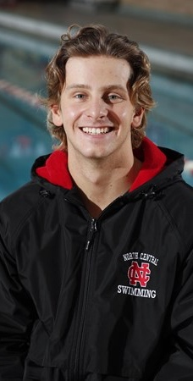
Austin blaser
Hometown: Wheaton, Illinois
Academic Major: Finance
Post-Collegiate Plans: I want to pursue a career in finance, but first, I’m going to enjoy some time off this summer.

Slide 38
North central women’s
swimming & diving

Slide 39
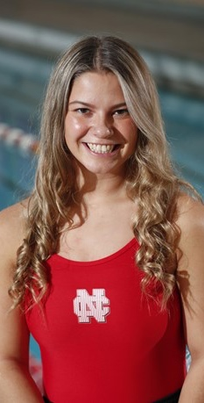
Savannah catalano
Hometown: Schaumburg, Illinois
Academic Major: Exercise science
Post-Collegiate Plans: eventually get my master's in Athletic Training.

Slide 40
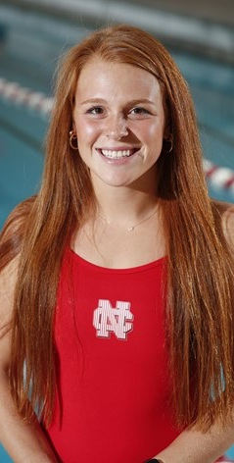
Annika cotner
Hometown: Norton Shores, Michigan
Academic Major: Health Science
Post-Collegiate Plans: After undergrad, I plan to continue my education to be a Physician’s Assistant. I have big goals of running marathons, half ironman’s and full ironman’s after my collegiate career is over!

Slide 41
wheaton men’s
swimming & diving

Slide 42
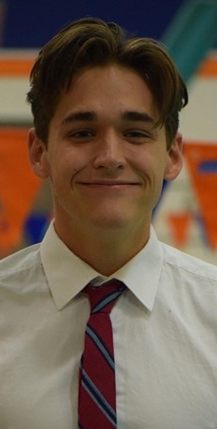
Christian cameron
Hometown: La Crosse, Wisconsin
Academic Major: Computer Science, Applied Mathematics
Post-Collegiate Plans: I am currently working at Oracle as a software engineer and plan to move to New York City in the summer.

Slide 43
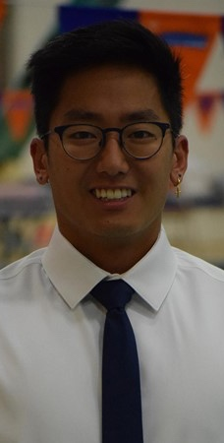
Joshua dull
Hometown: Zionsville, Indiana
Academic Major: International Relations and Spanish minor
Post-Collegiate Plans: Become tik tok famous and live in the Hype House in LA.

Slide 44
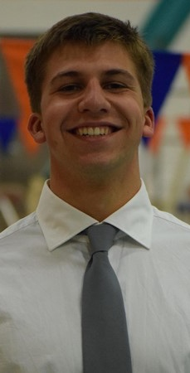
Christopher plimpton
Hometown: Parkton, Maryland
Academic Major: Applied Mathematics
Post-Collegiate Plans: After graduation, Chris plans to return to the East Coast, live near family, and pursue a career in financial planning and analysis.

Slide 45
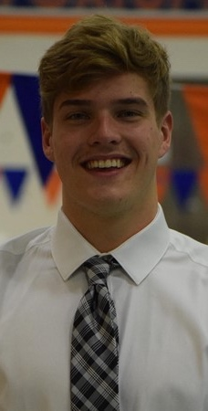
Will rinne
Hometown: Sanibel, Florida
Academic Major: Business Economics
Post-Collegiate Plans: Live somewhere a lot warmer than Wheaton.

Slide 46
Wheaton women’s
swimming & diving

Slide 47
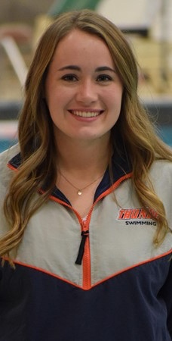
Kendra ecklund
Hometown: Rockford, Illinois
Academic Major: Elementary Education
Post-Collegiate Plans: I plan on staying in the Wheaton area to teach and hope to stay involved in swimming one way or another.

Slide 48
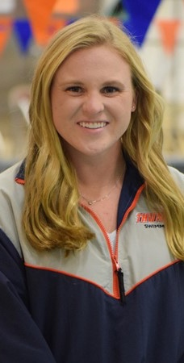
Mckenna lenderink
Hometown: Phoenix, Arizona
Academic Major: Biology
Post-Collegiate Plans: I plan to attend graduate school at Emory University to obtain my doctoral degree in nursing practice and ultimately become a Pediatric Primary Care Nurse Practitioner.

Slide 49
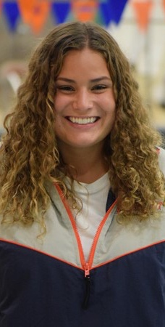
Emily meitz
Hometown: Edina, Minnesota
Major: Psychology, pre-nursing
Post-Collegiate Plans: After college, I plan on attending nursing school in either Minnesota or the Chicago area.

Slide 50
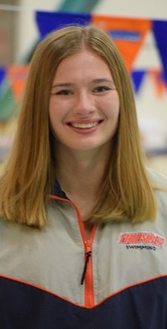
Kirsten peters
Hometown: Mankato, Minnesota
Academic Major: History and Secondary Education
Post-Collegiate Plans: I plan on teaching social studies at either the middle or high school level, hopefully in Colorado!

Slide 51
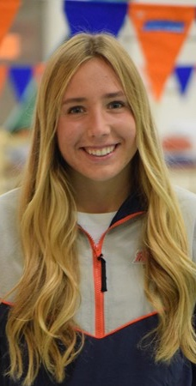
Kiki rogers
Hometown: Wheaton, Illinois
Academic Major: Applied Mathematics, Economics
Post-Collegiate Plans: In the short term, I am starting work at Chatham Financial as a financial analyst and moving to the Philadelphia area with my (now fiancé) but soon to be husband in July for this job. Long term, I am planning on going to law school and hopefully doing something in the legal and/or intelligence and national security community.

